Slide 1
\
Request for Proposals # 1
TCU Building Bridges Grant Program
A Science, Technology, Engineering & Math (STEM) grant-funding opportunity developed in partnership with the American Indian Higher Education Consortium (AIHEC) and the National Aeronautics and Space Administration (NASA)
Information Session & Call for proposals
Notes:
Welcome! We will take a few more minutes to let folks join the call. While we wait, please do put your name and TCU in the chat

Slide 2
Today’s Agenda
Welcome and Grounding
Call for proposals – Overview
Web Navigation Demo & discussion
Closing & Next Steps

Slide 3
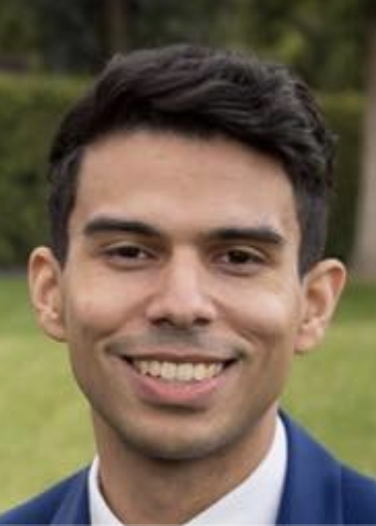
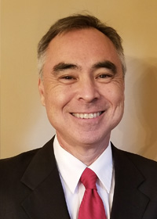
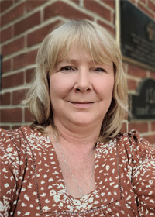
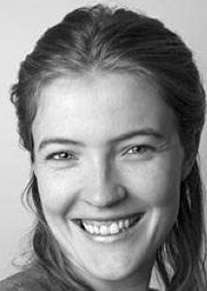
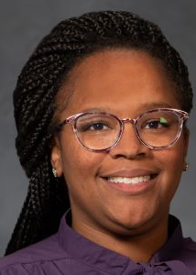
AIHEC & NASA Team

Slide 4
RFP Overview – Purpose
The Building Bridges Grant program is designed to provide funds to improve infrastructure, update academic program content, student research opportunities, faculty professional development, bridging activities, and other initiatives to support TCU efforts to develop and enhance their STEM programs.
Through providing funds on a semi-annual basis, it is NASA & AIHEC’s hope that the program will enhance the ability of TCUs to:
Provide high quality STEM education programs,
Participate in collaborative STEM research initiatives, and
Ensure the inclusion of American Indians and Alaskan Natives in a well-prepared NASA STEM workforce.

Slide 5
RFP Overview - FAQ
RFP RELEASE DATE: June 2024, TBD
PROPOSAL DUE DATE: 11:59 PM Eastern Time (ET) August 12, 2024
FUNDING AMOUNT: Multiple awards of up to $68,600 are available ($686,000 total each year)
ELIGIBILITY: Funds are available to faculty led teams from all accredited Tribal Colleges & Universities
ESTIMATED CONTRACT PERIOD: September 16, 2024 through September 16, 2026, or up to 2 years (24 months) from date of award, depending on the scope of the project. Projects designed for shorter periods of time will receive equal consideration. If projects last 1 year or less, projects can be renewed for a second cycle with an additional award.

Slide 6
RFP Overview – Priority Areas
Priority areas for support will include, but are not necessarily limited to:
Research opportunities for undergraduate students;
STEM program instrumentation/equipment acquisitions;
Course and curriculum enhancements (new courses, delivery support technologies)
Professional development for TCU faculty, including conferences and workshops;
In-person meetings with NASA researchers and engineers available for collaborative projects;
Other activities that increase TCU students’ interest and engagement in STEM fields, at the elementary, high school and undergraduate level, including participation in STEM enrichment activities, conferences, workshops and competitions.
If awarded, grantees will also receive ongoing technical assistance from both AIHEC as well as NASA to support program success.
What are some preliminary questions/ideas about how your TCU might want to use funds?
Notes:
We are trying our best to be expansive, not restrictive. Hopefully the message you take away from this is that there are a lot of possibilities, and if you are unsure, just ask!

Slide 7
Timeline
& Overview
To guide the application process, four webinars and workshops will be held to provide guidance, highlight best practices, offer resources, outline expectations, and address questions.
\
Each cycle, 5 webinars will take place to support the proposal development process.
1 – Information Session + Q & A (60 Min)
2 – Workshop: Community of Practice (June 14)
3 – Workshop: Building A Competitive Proposal (June 28)
4 – Workshop: Budget Development (July 15)
5 – Office Hours (August TBD)
*Webinars will also be recorded and uploaded to AIHEC.org for review
TCU faculty and staff who are interested but are not ready to submit a project are encouraged to attend workshops and learn more about the program, then submit an application for a future cycle.

Slide 8
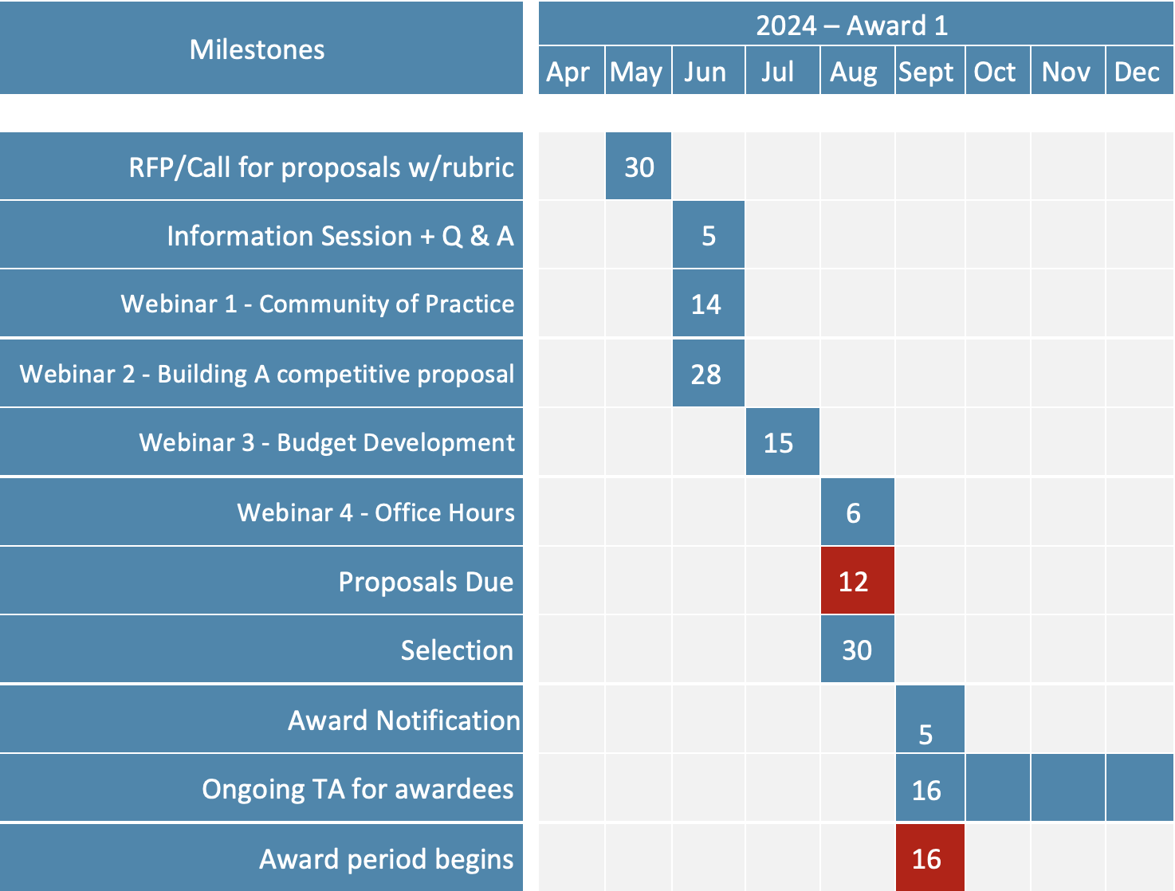
\
Timeline
& Overview
Notes:
Will be part of intro slides in future sessions

Slide 9
Web Navigation Demo – 3 parts
We will look at each section of the webpage together and go over any questions that may arise
We will spend 10 minutes navigating silently on our own, and return with any questions
In small groups, take some time to:
Introduce yourselves if not already acquainted
Talk through initial impressions, thoughts, questions
Share any project ideas you have, begin the pre-application!

Slide 10
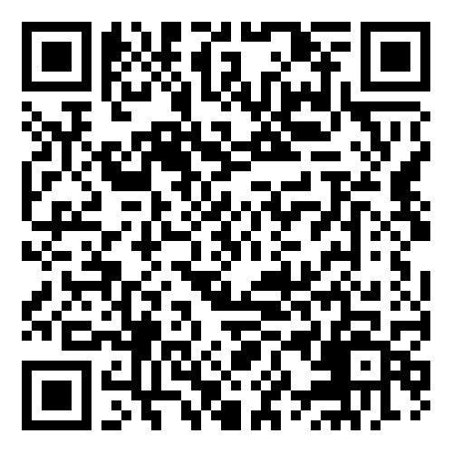
\
Thank you for coming!
Please complete our survey:
We will come back together next Friday, June 14th for a community of practice meeting
Notes:
https://app.smartsheet.com/b/form/d7b1cc948a424d849d977da80b65758e

